Slide 1


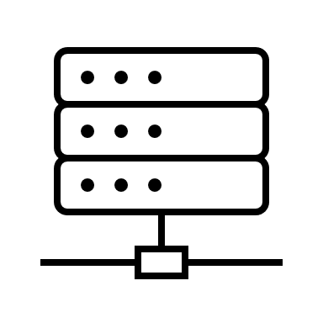

Envoy routing acceleration with Hyperscan
Filter selection
Access control
Routing
Up to 20% latency reduction
Latency (ms)
Route HTTP requests to different upstream clusters by checking their headers and block suspicious requests
single-core, 1024 conns
Where is regex majorly used in Envoy
Novel regex decomposition
SIMD-based pattern matching
Optimized for Intel Xeon
Rules
How does Hyperscan work

Slide 2
Where is regex majorly used in Envoy
Filter selection
Access control
Routing
Select different filters for different HTTP requests based on their headers
Block suspicious requests by matching network filter metadata with security policies
Route HTTP requests to different upstream clusters by checking their URL path

Slide 3
How does Hyperscan work
Novel regex decomposition
Graph-based string extraction
Graph-based regex decomposition
SIMD-based pattern matching
Efficient multi-string matching
Fast bit-based NFA
Optimized for Intel Xeon
High-performance multiple regex matching library
https://www.hyperscan.io/
Benefits from AVX512 and AVX512VBMI
Best performance in ICX and SPR

Slide 4
ICX client/server performance (draft) (cont’d)
-18% Avg
-20% p99
Latency (ms)
single-core, 1024 conns
-13% Avg
-17% p99
-3% Avg
Rules

Slide 5
Envoy routing acceleration with Hyperscan
KubeCon EU 2022
SATG/SSE/CSE Xie, Zhihao

Slide 6
Where is regex majorly used in Envoy
Filter selection
Access control
Routing
Select different filters for different HTTP requests based on their headers
Block suspicious requests by matching network filter metadata with security policies
Route HTTP requests to different upstream clusters by checking their URL path
Notes:
Before we start talking about routing acceleration with Hyperscan, let’s analyze the use of regular expressions in Envoy.
First of all, regular expressions can be used for filter selection. Envoy allows users to pass or skip the specified filter based on different parameters of the HTTP requests, such as their IPs, ports and headers.
For example, users can inject delays and abort requests with user-specified error codes to stage different failure scenarios on testing with HTTP fault filter, and users can skip the filter by checking particular HTTP request in order to get the correct result.
Second, regular expressions are heavily used in access control, which is easy to understand because in most IDS (intrusion detection system)/IPS (intrusion prevention system) and WAF (web application firewall), regular expressions are a major part of their rules.
Although users currently do not commonly use Envoy as a WAF, Envoy provides components like IP tagging and RBAC (role-based access control), which are used to block suspicious requests.
Finally, Envoy will also use regular expressions for routing. Envoy can route different HTTP requests to different upstream services by checking their URL path or other inputs.

Slide 7



Architecture
virtual_hosts:
- name: app
domains:
- "*"
routes:
- match:
safe_regex:
google_re2: {}
regex: safe.*cluster
route:
cluster: service-https
single_predicate:
input:
name: request-headers
typed_config:
"@type": HttpRequestHeaderMatchInput
header_name: :path
value_match:
safe_regex:
google_re2: {}
regex: safe.*cluster
Clients
Filters
Access control
Router
Upstream
services
rules:
- header:
name: ":method"
string_match:
exact: "GET"
- url_path:
path:
safe_regex:
google_re2: {}
regex: safe.*cluster
Notes:
This is a brief architecture of a system based on Envoy. The user uses Envoy as the ingress gateway. All requests will pass through different filters in turn for TLS encryption, content modification, generate statistics, access control, and finally arrive at the router for routing and forwarding. In each part of the system, Envoy can use regular expressions to match and judge.
The first code block is the configuration of Extension With Matcher, which can be used for filter selection.
The second code block is the configuration of RBAC rules, where the user specified that requests via GET with the path need to follow the corresponding rules.
The third code block is the HTTP router configuration, where the user routes request with the specified path to the service-https cluster.

Slide 8
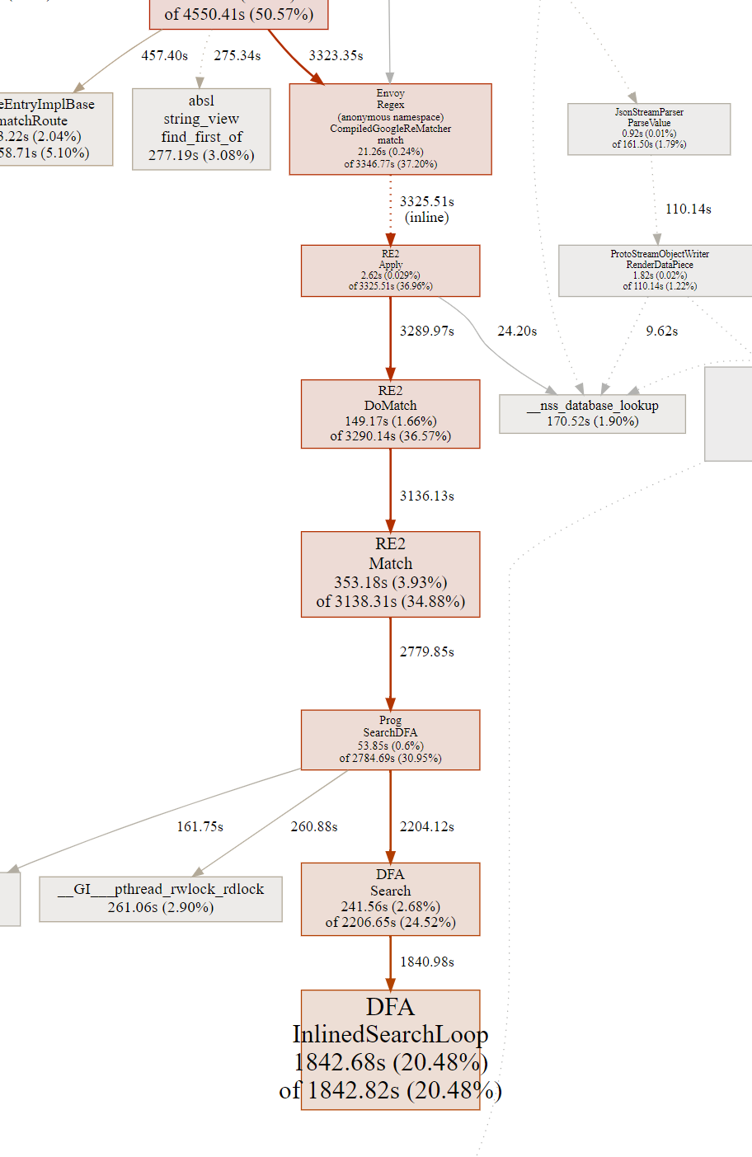
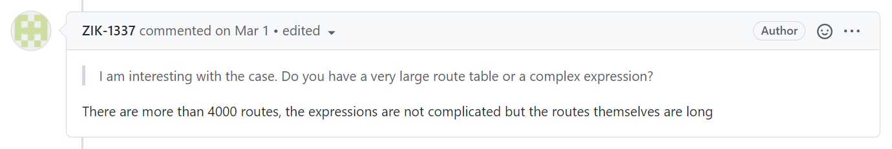
Performance impact of regex
A community user complains more than 20% CPU utilization consumption on regex matching
Their routing table is consisted of more than 4000 routes with long regex
Regex is versatile and convenient, but heavy
Issue: High CPU usage for matching routes (re2::DFA::InlinedSearchLoop) #20147
Notes:
In the community, we found a case about regular expressions.
A user mentioned that it used Envoy for routing and configured a routing table consisting of more than 4000 long regular expressions.
The user found that nearly 20% of the CPU resources were used for regular expression matching, making Envoy much less capable as a router.
When users find that exact match and prefix match do not meet their needs, they choose to use regular expression matching, which is flexible and convenient, and can meet their complex requirements.
But we also have to admit that regular expressions are very expensive and consume a lot of computational resources on top of versatility compared to exact match and prefix match, and this is a much-needed optimization point.
So, we submitted a patch to the community for integrating Hyperscan into Envoy as an alternative regex matcher.

Slide 9
How does Hyperscan work
Novel regex decomposition
Graph-based string extraction
Graph-based regex decomposition
SIMD-based pattern matching
Efficient multi-string matching
Fast bit-based NFA
Optimized for Intel Xeon
High-performance multiple regex matching library
https://www.hyperscan.io/
Benefits from AVX512 and AVX512VBMI
Best performance in ICX and SPR
Notes:
Hyperscan is a high-performance open-source multiple regular expressions and string matching library, which uses hybrid automata techniques to allow simultaneous matching of large numbers of regular expressions across data.
For the part of regular expressions, due to the slow NFA led by complex regular expressions, Hyperscan uses graph-based regular expression decomposition which can deliver more insights to optimize the speed of regular expression decomposition.
It also uses SIMD-based pattern matching to achieve fast bit-based NFA and is optimized specifically for AVX512 and AVX512VBMI on Ice Lake and Sapphire Rapids CPUs.

Slide 10
Hyperscan integration with Envoy
Default
Hyperscan (Single)
Hyperscan (Multiple)
safe_regex:
google_re2: {}
regex: safe.*cluster
custom_match:
name: hyperscan
typed_config:
"@type": Hyperscan
regexes:
- regex: safe.*cluster
caseless: true
custom_match:
name: hyperscan
typed_config:
"@type": Hyperscan
regexes:
- regex: safe.*cluster
caseless: true
quiet: true
id: 1
- regex: bad.+request
utf8: true
quiet: true
id: 2
- regex: 1 & !2
combination: true
Logical matching
Notes:
In the patch integration Hyperscan with Envoy, we provide the used of Hyperscan as an alternative to the regular expression matcher.
Unlike the default regular expression matcher, Hyperscan is introduced as an input matcher and the user needs to change the matching method from safe regex to custom matcher, and because of this, Hyperscan matcher provides more features than the default regular expression matcher.
First, Hyperscan matcher allows users to enter multiple matching patterns at the same rule, and users can merge multiple regular expression matching rules that have the same action, providing faster matching capabilities while reducing lengthy configuration.
For situations when a user requires behavior that depends on the presence or absence of matches from groups of patterns, Hyperscan matcher also provides the ability of logical combination.
As in the example, the user can match content that has a safe cluster and no bad request.

Slide 11
Hyperscan performance (draft)
-44%
Run with bazel run -c opt //contrib/hyperscan/matching/input_matchers/test:hyperscan_speed_test
Notes:
In our comparison tests, Hyperscan can reduce the matching time overhead by 40% in Ice Lake servers.
You can also run the following command to compare on your own environment.

Slide 12

Evaluation
Evaluation points
Performance of regex routing between the default regex engine (RE2) and Hyperscan
Client/Server benchmarking for application-level latency performance improvement
Environment setup
ICX
fortio 1.18.2
Envoy
Nginx 1.18.0
Build Envoy with bazel build //contrib/exe/envoy-static
Also available in the official Envoy contrib Docker image
Notes:
Then, we have evaluated the cases based on user reports in the community. We have built the latest Envoy on Ice Lake server. Currently, the patch that integrates Hyperscan into Envoy has been merged into the upstream code, so users can easily compile Envoy with Hyperscan with the following command, and also get the official Docker image to use.
We want to show that Hyperscan has better performance compared to the default regular expression engine, and we can see a reduction in latency from the client/server tests.
In our tests, we use fortio as the load generator and Nginx as the web server, which is the upstream service for this system.
We will compare the optimization ability of Hyperscan when 100, 1000 and 4000 rules are used, respectively. We also design cases with fewer connections, 64, and more connections, 1024, to accommodate both ingress gateway and sidecar proxy usage.

Slide 13
Demo

Slide 14
ICX client/server performance (draft)
Latency (ms)
single-core, 64 conns
-20% Avg
-20% p99
-15% Avg
-21% p99
-5% Avg
Rules
Notes:
In the fewer connections case, like a sidecar proxy, Hyperscan can gain 5% performance improvement with 100 rules and 20% with 4000 rules.

Slide 15
ICX client/server performance (draft) (cont’d)
-18% Avg
-20% p99
Latency (ms)
single-core, 1024 conns
-13% Avg
-17% p99
-3% Avg
Rules
Notes:
And in the more connections case, like an ingress gateway, Hyperscan also can gain nearly 20% performance improvement with 4000 rules.

Slide 16
Future works
Hyperscan can be plugged into filter matching and HTTP routing currently and can perform limited security operations with filter integration. We will extent the usage to more filters like role-based access control (RBAC) or WASM later.
Hyperscan is an input matcher for the latest unified matching API which is in alpha and has not been adopted by Istio yet. We will continue to promote the development and mature of the unified matching API.
Hyperscan: https://www.hyperscan.io/
Hyperscan Envoy API: Hyperscan matcher
Notes:
Next, we will look at the use of Hyperscan in Envoy's access control. We plan to push the community to optimize RBAC and other access control extensions to be compatible with Hyperscan matcher, which is also more efficient than the default regular expression engine in WAF scenarios where regular expressions are used more than routing.
In addition, Hyperscan can currently only be used in the unified matching API as a replacement of the current Envoy matching API, which is not yet mature and is not compatible with Istio. We will also contribute to the development of the unified matching API.
For more information about Hyperscan and Hyperscan matcher, you make access the links below.

Slide 18
Backup

Slide 19
Core client/server performance (draft)
Latency (ms)
quad-core, 2000 conns
-20% Avg
-36% p99
-6% Avg
-8% p99
-2% Avg
-5% p99
Rules

Slide 20
ICX C/S performance (draft)
Latency (ms)
Single core, 100 rules
-5% Avg
-3% p99
Conns

Slide 21
ICX C/S performance (cont’d) (draft)
Latency (ms)
Single core, 1000 rules
-14% Avg
-16% p99
Conns

Slide 22
ICX C/S performance (cont’d) (draft)
Latency (ms)
Single core, 4000 rules
-20% Avg
-18% p99
Conns

